Slide 1
CSS
Week 2, Day 2

Slide 2
Review: HTML
Tag-based language that defines structure of web page
Elements
<h1>, <h6>, <p>, <a>, <img>, <ul>, <ol>, <table>, <iframe>, etc.
Attributes
name=”value”

Slide 3
Review: Style Attribute
<tagname style=”property:value;”>
Specifies the style of an element
Properties:
background-color
color
font-family
font-size
text-align
<h1 style=”color:blue;”>hello</h1>
<p> style=”color:red;”>bye</p>
hello
bye

Slide 4
Review: Div Element
An empty container element
Useful for applying a specific styling for all elements within <div>
<div style=”color:red;”>
…
</div>

Slide 5
CSS

Slide 6
Functionalities: HTML and CSS
HTML (Hypertext Markup Language)
Defines structures
CSS (Cascading Style Sheets)
Gives styles to elements in structures

Slide 7
CSS in HTML
Three different ways to define CSS styling
Inline CSS
Internal CSS
External CSS

Slide 8
Inline CSS
Defines style of a single HTML element
Uses the “style” attribute, as demonstrated before
<h1 style=”color:blue;”>hello</h1>
<p> style=”color:red;”>bye</p>
hello
bye

Slide 9
Internal CSS
Defines style of all elements of specific type in page
CSS styling defined in the “style” element within <head>
<head> <style> h1 {color: blue;} p {color: red;} </style> </head>
<body>
...
</body>

Slide 10
External CSS
Identical to internal CSS, except for the location of the CSS code
CSS styling defined in an external .css file and linked in HTML <head>
Best practice for defining CSS!
Use external CSS whenever possible
HTML file:
...
<head> <link rel="stylesheet" href="styles.css"> </head>
...
styles.css:
h1 {
color: blue;
}
p {
color: red;
}

Slide 11
Syntax
Consists of selectors and declaration blocks
Selector: h1
Declaration block: { … }
Each declaration consists of property and value
Property: color, font-size
Value: blue, 12px
h1 {
color:blue;
font-size:12px;
}

Slide 12
Declarations
Pairs of properties and values
Properties:
background-color
color
font-family
font-size
text-align
and more
h1 {
color:blue;
font-size:12px;
}

Slide 13
Selectors
Allows CSS to locate the appropriate HTML elements
Three types of selectors:
Element selector
Id selector
Class selector
h1 {
color:blue;
font-size:12px;
}
h1 is an example of an element selector.

Slide 14
Id Selectors
Finds HTML elements based on their “id” attribute
Each id should be unique in a page
Only one element with a particular id
No more than one id per element
HTML file:
...
<p id=”para1”>hello</p>
...
CSS file:
#para1 {
text-align:center;
color:red;
}

Slide 15
Class Selectors
Finds HTML elements based on their “class” attribute
Not unique
Multiple elements in a same class
Each element can be in multiple classes
HTML file:
...
<p class=”para1 para3”>hello</p>
...
CSS file:
.para1 {
text-align:center;
color:red;
}

Slide 16
Other Selector Specifications
Specifying HTML element types of a particular class
Grouping multiple selectors
p.center {
...
}
h1, h2, p.center {
...
}

Slide 17
Other Selector Specifications
Descendant selector (space): finds all the elements of specific type that are inside another specific type
Child selector (>), adjacent sibling selector (+), general sibling selector (~), etc.
div p {
...
}
This descendant selector (div p) selects all elements of type p that are inside div elements.

Slide 18
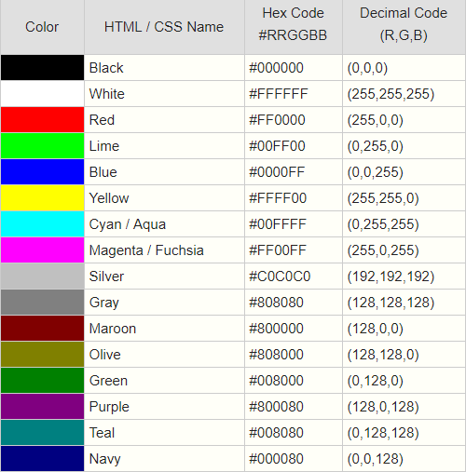
Colors
Different ways to represent color
Valid name: red
RGB value: rgb(255,0,0)
HEX value: #FF0000
h2 { background-color:#FF0000; color:rgb(255,255,255); }

Slide 19
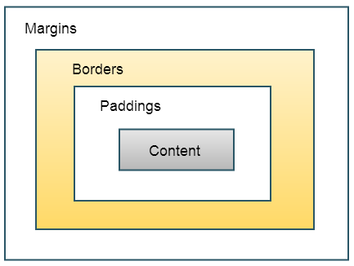
CSS Box Model
Relevant properties:
margin
border
padding
width
height

Slide 20
CSS Box Model
Properties width and height specifies the size of only the content
CSS file:
div { background-color: lightgrey; width: 300px; border: 25px solid green; padding: 25px; margin: 25px; }
HTML file:
...
<div>Hello</div>
...

Slide 21
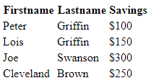
Example: Table
<table>
<tr> <th>Firstname</th> <th>Lastname</th> <th>Savings</th> </tr> <tr> <td>Peter</td> <td>Griffin</td> <td>$100</td> </tr> ... <tr> <td>Cleveland</td> <td>Brown</td> <td>$250</td> </tr>
</table>
Plain HTML table

Slide 22
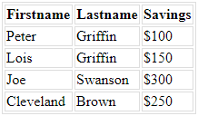
Example: Table
Add a border to the table and all its entries
Text-align all entries to the left
table, td, th { border: 1px solid #ddd; text-align: left; }

Slide 23
Example: Table
Collapse borders (combines two layers of borders into one)
Extend width to fill up the page (makes it more consistent and readable)
table, td, th { border: 1px solid #ddd; text-align: left; } table { border-collapse: collapse; width: 100%; }

Slide 24
Example: Table
Add padding to each entry to increase readability
table, td, th { border: 1px solid #ddd; text-align: left; } table { border-collapse: collapse; width: 100%; }
th, td { padding: 15px; }

Slide 25
Example: Table
table, td, th { border: 1px solid #ddd; text-align: left; } table { border-collapse: collapse; width: 100%;
}
th, td { padding: 15px; }
th {
background-color: #4CAF50; color: #FFFFFF; }
Add color variation to distinguish the header row

Slide 26
Example: Navigation Bar
Can be implemented as a list of links
<ul> <li><a class="active" href="home.html">
Home
</a></li> <li><a href="news.html">
News
</a></li> <li><a href="contact.html">
Contact
</a></li> <li><a href="about.html">
About
</a></li>
</ul>

Slide 27
Example: Navigation Bar
ul { list-style-type: none; margin: 0; padding: 0; overflow: hidden; border: 1px solid #e7e7e7; background-color: #f3f3f3; } li { float: left; } li a { display: block; color: #666; text-align: center; padding: 16px; text-decoration: none; } li a.active { color: white; background-color: #4CAF50; }
Zero margin and padding attaches the bar to the top edge of the page.
Left float allows all elements in the list to be contained in one line.
Block display allows you to click the entire area rather than just the text.
No text-decoration removes the color and underline of the links.

Slide 28
Lab
Create a navigation bar with at least 3 tabs
Hint: You must create 3 html files, each of which has a navigation bar
Fill up the contents of each tab with any elements you want, and style them with CSS to make them look better
Include a table in at least one of the tabs

